Slide 1
DevOps Certification Training

Slide 2
CI/CD Pipeline with Jenkins

Slide 3

Set up Jenkins
Integrate Jenkins with Git, Maven, and Ant
Illustrate Jenkins builds
Execute remote jobs using Jenkins
Notes:
Trainer Notes:
Summarize the points given on the slide and set an expectation about learning these pointers in this lesson.

Slide 4
Continuous Integration, Continuous Delivery, and Continuous Deployment

Slide 5
Continuous Integration
Continuous integration (CI) is a development practice in which all development work is integrated as early as possible.
The developers need to commit the changes to the source code in a shared repository at regular intervals. Every commit made in the repository is then built.
It requires the developers to have regular builds. The general practice is that whenever a code commit occurs, a build should be triggered.
This process helps to identify the errors in the early stages of a project.
Notes:
Trainer Notes:
Explain the concept of continuous integration.

Slide 6
Tasks Involved in Continuous Integration
◉
Generating reports and analyzing
Developing and compiling
Performing functional tests and labeling code
Continuous
Integration
Performing unit tests
Performing preproduction deployment
Integrating with DB
Notes:
Trainer Notes:
Explain the tasks involved in continuous integration.

Slide 7
Advantages of Continuous Integration
Continuous integration automatically monitors the health of your codebase, code quality, and code coverage metrics.
Technical debts are kept down, and maintenance costs are low.
Publicly-visible code quality metrics encourage developers to improve their code quality.
Automated end-to-end acceptance tests provide a clear picture of the current state of development efforts.
Notes:
Trainer Notes:
Elaborate the advantages of continuous integration.

Slide 8
Advantages of Continuous Integration
Continuous integration reduces risk by providing faster feedback.
CI tools are designed to help identify and fix integration and regression issues faster, resulting in fewer bugs and quicker delivery.
CI helps simplify and accelerate delivery by automating the deployment process.
Automating the deployment process allows testers and end users quick access to the software.
Notes:
Trainer Notes:
Elaborate the advantages of continuous integration.

Slide 9

Continuous Delivery
Continuous delivery is an extension of continuous integration since it automatically deploys all code changes to a testing and/or production environment after the build stage.
With continuous delivery, any successful build that has passed all the relevant automated tests and quality gates can potentially be deployed into production and be in the hands of the end user within minutes.
But this process is not automatic.
It is the business and not the IT that decides the best time to deliver the latest changes.
Notes:
Trainer Notes:
Explain what is continuous delivery.

Slide 10
Continuous Deployment
Continuous deployment is a step up from Continuous Delivery in which every change in the source code is deployed to production automatically, without explicit approval from a developer.
Faster return on investment for each feature as it gets developed
Faster feedback from end users on each new feature as it is released to production
Benefits of CD
Notes:
Trainer Notes:
Explain what is continuous deployment.

Slide 11
Prerequisites for CI/CD
Here are a few technical prerequisites for adopting the CI/CD process:
Automated build, test, package, and deploy operations
Trunk-based development
Quick pipeline execution
Zero-downtime deployment
Quick failure recovery
Notes:
Trainer Notes:
Mention the prerequisites for CI/CD.

Slide 12
Introduction to Jenkins

Slide 13

What Is Jenkins?
Jenkins is a powerful automation tool written in Java.
It allows continuous integration and continuous delivery of projects.
It allows to continuously deliver the software by integrating with number of testing and deployment technologies.
It supports Windows, MacOS, and Unix-like operating systems.
Notes:
Trainer Notes:
Explain what is Jenkins.
Explain uses of Jenkins

Slide 14
Benefits of Jenkins
Rich plugins library and strong community support
Limitless integrations
04
05
Portable and platform-independent tool
03
Easy to install and configure
02
01
Free CI tool and cost-effective
Notes:
Trainer Notes:
Elaborate the benefits of Jenkins

Slide 15

Role of Jenkins in DevOps
Jenkins is used to perform different roles:
Build
Testing
Integration
Reporting
Deployment
Notes:
Trainer Notes:
Explain the role of Jenkins in DevOps.

Slide 16
Setting Up Jenkins
Duration: 20 Min.
Problem Statement:
Set up and run Jenkins.
Notes:
Trainer Notes:
Explain the problem statement and move to the next slide before proceeding towards the practical.

Slide 17
Unassisted Practice: Guidelines
Steps to set up Jenkins:
Download the Java Runtime Environment
Download and install the Jenkins app
Notes:
Trainer Notes:
Walk through the steps in detail.

Slide 18
Jenkins as a CI Tool

Slide 19
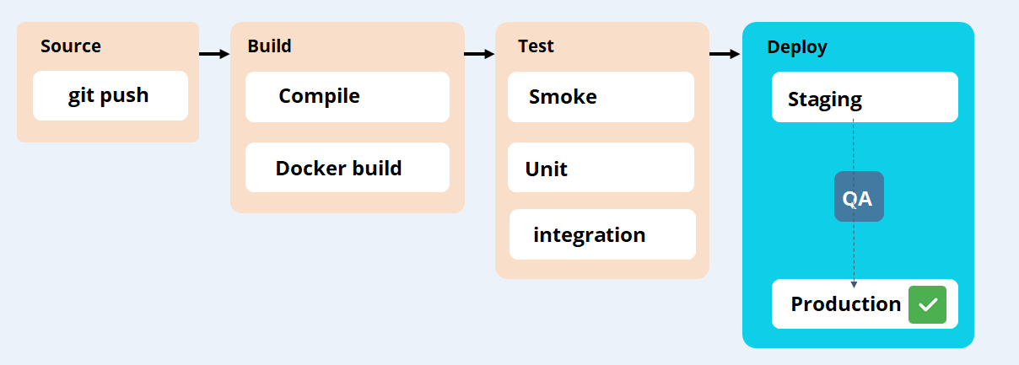
Stages of a CI/CD Pipeline
A CI/CD pipeline is essentially a runnable specification of the steps that need to be performed in order to deliver a new version of a software product. A CI/CD pipeline usually has the following stages:
Notes:
Trainer Notes:
Explain different stages of CI/CD pipeline.

Slide 20




How to Achieve CI with Jenkins?
All the commits are built
Jenkins CI will check the builds
Executable code is ready for deployment
If build is ok
Build failed, team notified
Group of developers commit changes at regular intervals
Notes:
Trainer Notes:
Explain how CI is achieved by Jenkins.

Slide 21
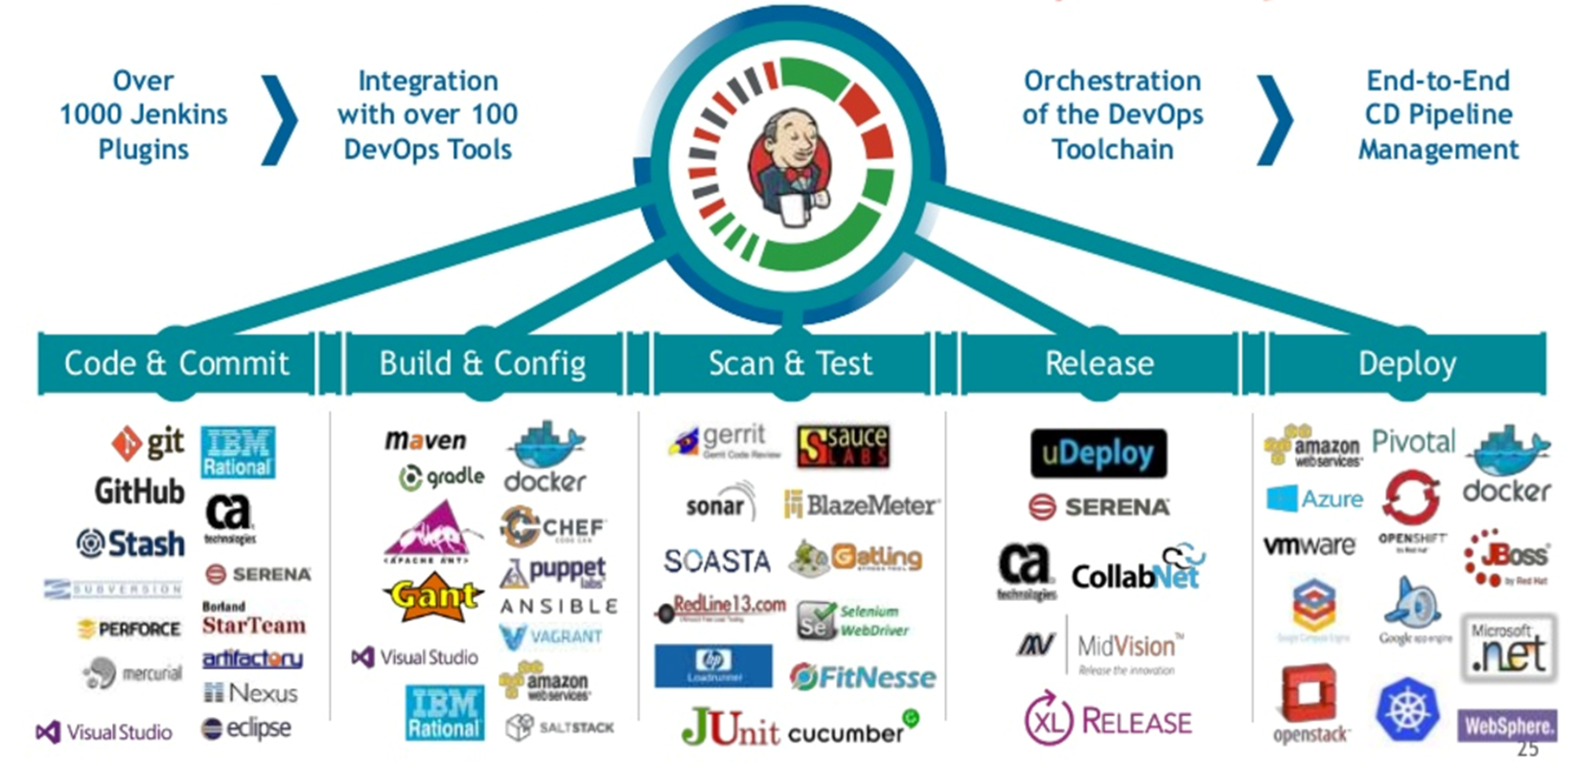
CI with Jenkins
Notes:
Trainer Notes:
Explain how CI can be done using Jenkins.

Slide 22
Understanding Jenkins Build Jobs

Slide 23
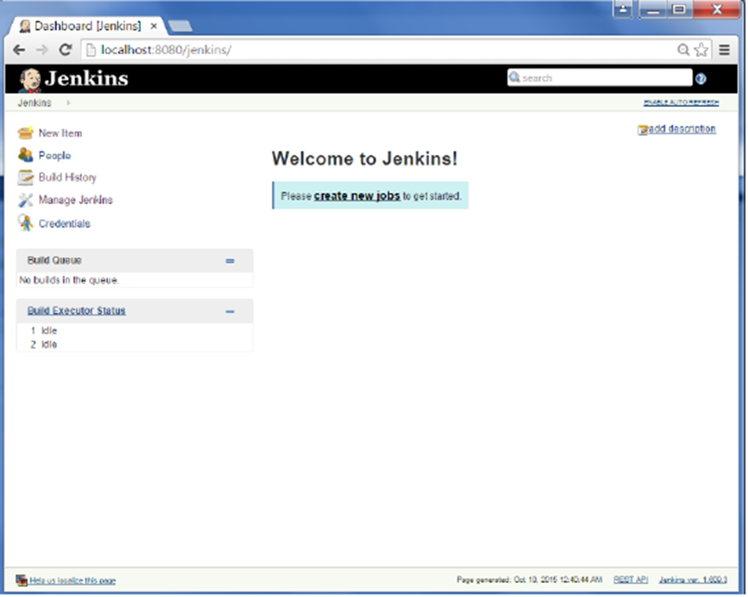
Jenkins Build Jobs
You can create new build jobs by clicking on the New Item button shown in the UI below. This will give you the list of build jobs available in Jenkins to choose from.
Types of build job in Jenkins:
Freestyle project
Maven project
External job
Multi-configuration project
Pipeline
Folder
GitHub organization
Multibranch pipeline
Notes:
Trainer Notes:
Explain what is Jenkins build jobs.

Slide 24

Poll SCM, Webhook, and Build Periodically
Poll SCM
Webhook
Build Periodically
Polling involves checking the version control server at regular intervals for any changes that have been committed.
Webhooks provide your application a way of consuming new event data from an endpoint and instead of sending repeated requests for new events, you provide the endpoint with a URL,which your application monitors.
Build periodically builds the project periodically even if nothing has changed.
It might tests that should be run periodically (every morning for example) or a DB clean up Jenkins job or any other Jenkins job.
Notes:
Trainer Notes:
Explain what is Jenkins build jobs.

Slide 25

Scheduling Jenkins Jobs
Scheduled builds simply trigger your build job at regular intervals.
This strategy can be used for regular nightly builds.
Scheduled builds are not the same as continuous integration and could be done with something as simple as a Unix cronjob.
Notes:
Trainer Notes:
Explain why scheduling is used for Jenkins job.

Slide 26

Scheduling Jenkins Jobs
Continuous integration requires faster feedback than scheduled builds.
Scheduled builds can be used for long running build jobs, where quick feedback is less critical.
Notes:
Trainer Notes:
Explain why scheduling is used for Jenkins job.

Slide 27
Scheduling Jenkins Jobs
Jenkins uses cron-style syntax for scheduling the jobs.
Fields
The meaning of these fields are as follows:
MINUTE: Minutes within the hour (0–59)
HOUR: The hour of the day (0–23) DOM
DOM: The day of the month (1–31)
MONTH: The month (1–12)
DOW: The day of the week (0–7), where 0 and 7 are Sunday
Notes:
Trainer Notes:
Explain the syntax for job scheduling.

Slide 28
Scheduling Jenkins Jobs
Here are the shortcut syntaxes used for scheduling build jobs:
Notation | Meaning | Example
* | Represents all possible values for a field | * * * * * means once a minute
M–N | Defines ranges | 1-5 in the DOW field would mean Monday to Friday
/ | Defines skips through a range | */5 in the MINUTE field would mean every five minutes
Comma-separated list | Indicates a list of valid values | 15,45 in the MINUTE field would mean at 15 and 45 minutes past every hour
Shorthand values |  | @yearly, @annually, @monthly, @weekly, @daily, @midnight, and @hourly
Notes:
Trainer Notes:
Explain the syntax for job scheduling.

Slide 29
Integrating Git with Jenkins
Duration: 30 Min.
Problem Statement:
You are asked to integrate Git with Jenkins.
Notes:
Trainer Notes:
Explain the problem statement and move to the next slide before proceeding towards the practical.

Slide 30
Assisted Practice: Guidelines
Steps to set up Jenkins:
Install Git plugin
Notes:
Trainer Notes:
Walk through the steps in detail.

Slide 31
Creating a Freestyle Build Job
Duration: 20 Min.
Problem Statement:
You have been asked to create a freestyle build job using Jenkins to compile and run a simple Java program.
Notes:
Trainer Notes:
Explain the problem statement and move to the next slide before proceeding towards the practical.

Slide 32
Assisted Practice: Guidelines
Steps to create a freestyle build job:
Create a GitHub repository
Add a Java program to the repositor
Create a freestyle build job in Jenkins
Build the Java program with Jenkins
Notes:
Trainer Notes:
Walk through the steps in detail.

Slide 33
Integrate Maven with Jenkins
Duration: 40 Min.
Problem Statement:
You are asked to integrate Maven with Jenkins.
Notes:
Trainer Notes:
Explain the problem statement and move to the next slide before proceeding towards the practical.

Slide 34
Assisted Practice: Guidelines
Steps to integrate Maven with Jenkins:
Install Maven plugin
Set the Global Tool Configuration
Fork a sample repository
Integrate Maven with Jenkins
Notes:
Trainer Notes:
Walk through the steps in detail.

Slide 35
Integrating Ant with Jenkins
Duration: 30 Min.
Problem Statement:
You are asked to integrate Ant with Jenkins.
Notes:
Trainer Notes:
Explain the problem statement and move to the next slide before proceeding towards the practical.

Slide 36
Assisted Practice: Guidelines
Steps to integrate Ant with Jenkins:
1. Create a GitHub repository
2. Add build.xml file to the repository
3. Set the Global Tool Configuration
4. Integrate Ant with Jenkins
Notes:
Trainer Notes:
Walk through the steps in detail.

Slide 37
Builds

Slide 38

Parameterized Builds
Jenkins simply provides an interface to enter values for the parameters. It is the job of the build script to analyze and process the parameter values correctly.
The parameterized build plugin lets you configure parameters for a build job that are either entered by the user when the build job is triggered or from another build job.
When running a build job involving web tests, you can specify the browser to run the Selenium or WebDriver tests in. You can also upload files to be used by build jobs.
For a deployment build job, you can either choose the target environment from a drop-down list or specify the version of the application.
Notes:
Trainer Notes:
Explain parameterized builds.

Slide 39
Remote Triggering of a Parameterized Build
Duration: 30 Min.
Problem Statement:
You are asked to execute the remote triggering of a parameterized build.
Notes:
Trainer Notes:
Explain the problem statement and move to the next slide before proceeding towards the practical.

Slide 40
Assisted Practice: Guidelines
Steps to execute the remote triggering of a parameterized build:
Configure a parameterized build in Jenkins
Trigger a parameterized build remotely
Notes:
Trainer Notes:
Walk through the steps in detail.

Slide 41
Continuous integration is a development practice of integrating code into a shared repository.
Jenkins is a powerful automation tool written in Java which allows continuous integration and continuous delivery of projects.
A CI/CD pipeline usually has four stages: source, build, test, and deploy.
Notes:
Trainer Notes:
Summarize the points given on the slide.

Slide 43
What is Jenkins?
1
Jenkins is an open source continuous and integration.
Jenkins is an open-source continuous integration and continuous delivery tool.
Jenkins is an open source only continuous delivery tool.
None of these

Slide 44
What is Jenkins?
1
Jenkins is an open source continuous and integration.
Jenkins is an open-source continuous integration and continuous delivery tool.
Jenkins is an open source only continuous delivery tool.
None of these
B
Jenkins is an open-source continuous integration and continuous delivery tool.

Slide 45
What is continuous integration?
2
Saving the code regularly.
Compiling the code regularly.
Compiling and committing code to a shared repository regularly.
Compiling and committing the code to the local repository regularly.

Slide 46
What is continuous integration?
2
Saving the code regularly.
Compiling the code regularly.
Compiling and committing code to a shared repository regularly.
Compiling and committing the code to the local repository regularly.
C
Continuous Integration (CI) is a development practice where developers integrate code into a shared repository frequently.

Slide 47
Continuous delivery and continuous deployment are synonyms and refer to the same concept. Is the statement true or false?
3
True
False

Slide 48
Continuous delivery and continuous deployment are synonyms and refer to the same concept. Is the statement true or false?
3
True
False
B
There is a subtle difference between continuous delivery and continuous deployment. The code is automatically deployed to production in continuous deployment, whereas deployment is manual in continuous Delivery.

Slide 49
Which is the default port that Jenkins runs on?
4
5000
8080
3000
9090

Slide 50
Which is the default port that Jenkins runs on?
4
5000
8080
3000
9090
B
By default, Jenkins runs on port 8080.

Slide 51
Which of the following processes is not supported by CI ?
5
Automated unit test
Automated code quality checks
Automated build process
Automated deployment to production

Slide 52
Which of the following processes is not supported by CI ?
5
Automated unit test
Automated code quality checks
Automated build process
Automated deployment to production
D
Automated deployment to production is not supported by CI.

Slide 53
Building a Maven Project with Jenkins
Lesson-End Project
Project Agenda: Use Jenkins to create a Maven build job which will compile and run a local Maven project.
Description: You are a DevOps engineer, and you are asked to create a sample maven project, add a sample java code in it, and deploy the same on Jenkins.
Notes:
Trainer Notes:
Explain the problem statement.

